Slide 1

Analysis of The completely Fair Scheduler
By:
Nathan DeKeyrel and Wade Fortson

Slide 2
Goals of Project
We wanted to provide an analysis of an actual scheduling algorithm used in modern operating systems
While researching scheduling algorithms, we found the Completely Fair Scheduler used in Linux
We wanted implement CFS to compare our implementation and Linux’s

Slide 3
background
In class we saw 6 different scheduling algorithms
FCFS, RR, SPN, SRT, HRRN, and FB
With a good understanding of these, we wanted to see what’s used in industry
Seeing how our own implementation compares

Slide 4
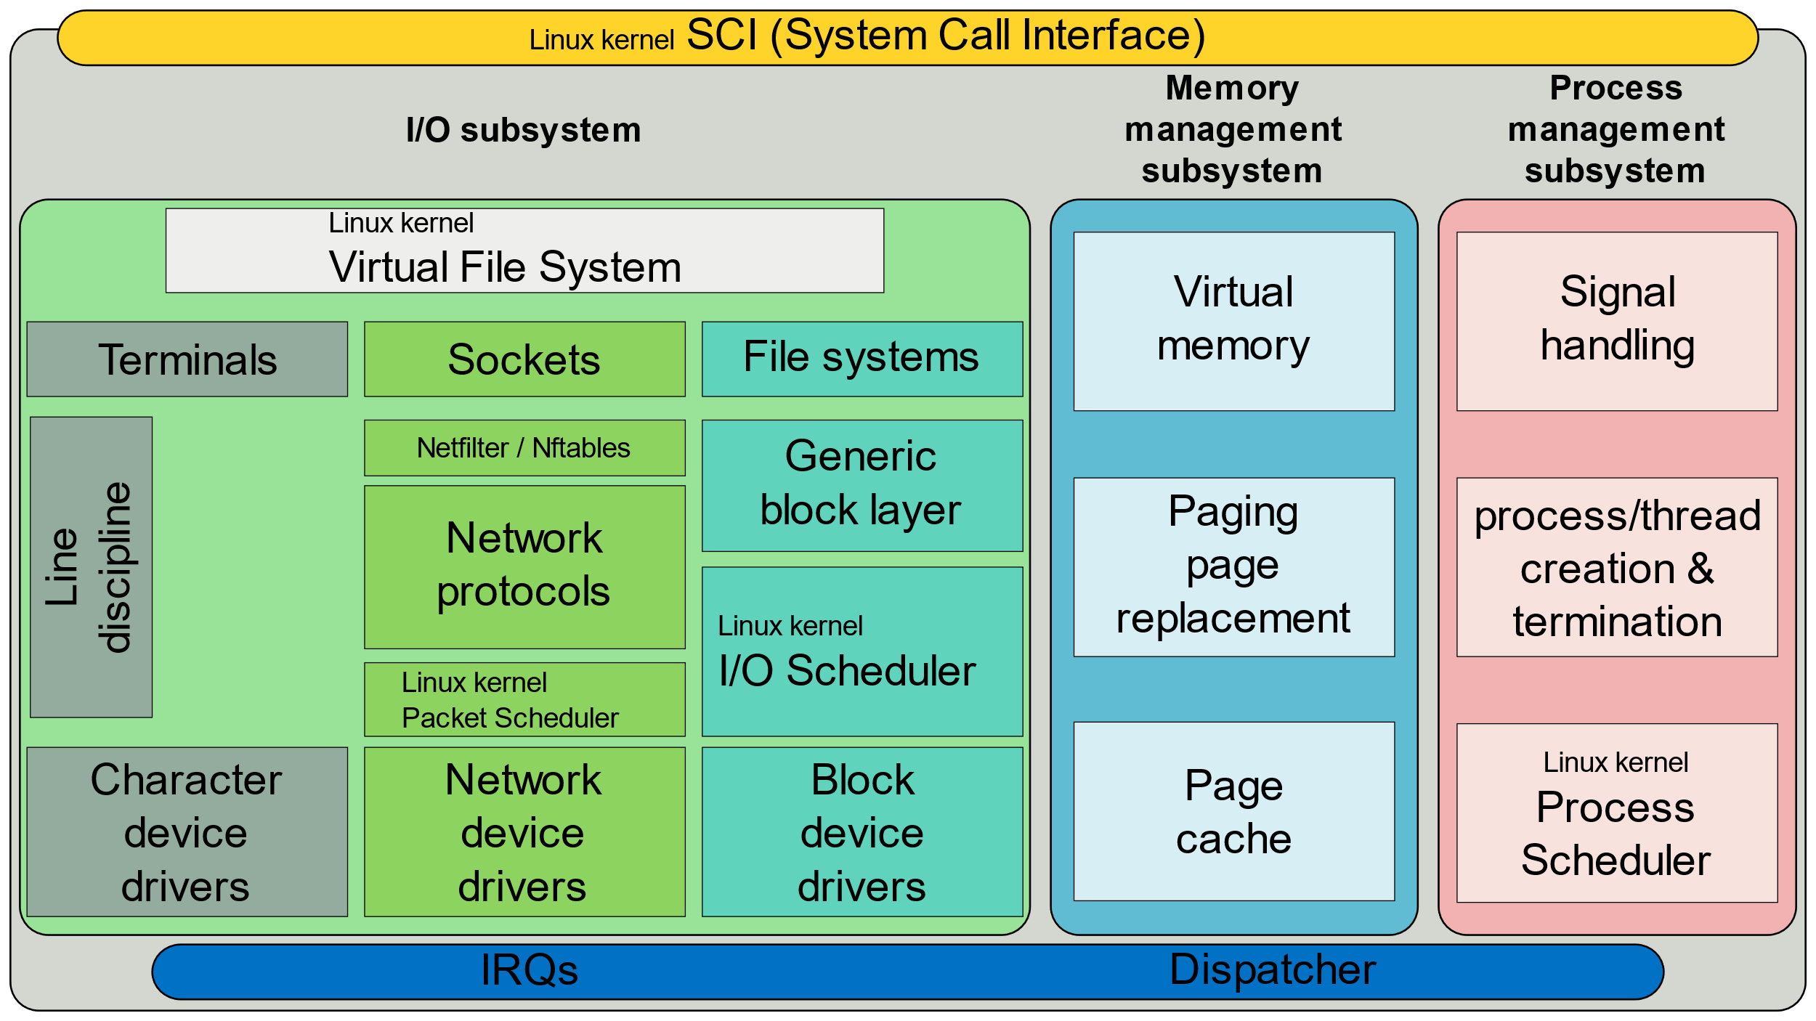
Simplified Linux Diagram

Slide 5
CFS in Linux
The main scheduler used by the Linux kernel since 2007
Uses Red-black tree for sorting – O(log n) insertion and deletion
Inspired by ‘Ideal Fair Queueing’ in network packet scheduling
Replaced the O(1) scheduler previously used

Slide 6
O(1) Scheduler
Did not contain any algorithms that ran worse than O(1) time
Every part of scheduler guaranteed to complete in an upper-bounded, definite time regardless of the size of input
Algorithm
Uses 2 arrays – Active and Expired
Each process given fixed time quantum
After exhausted, preempted and moved to Expired
Once active emptied, swap arrays (using pointers) and repeat

Slide 7
Issues with O(1) Scheduler
Identifies interactivity based on average sleep time
Processes that wait for user input could be assumed inactive
Gives priority to interactive tasks
All calculations to determine interactivity are prone to miscalculation
High complexity
Extremely complicated algorithms with many edge cases
Unpredictable
Prioritizing response to user input can cause random shift in ordering
Penalizing non-interactive by lowering priority

Slide 8

Design of CFS
Goals
Reduce complexity – No special cases
Fair CPU distribution across processes
Better responsiveness – no misclassification of tasks
Predictable

Slide 9
CFS Groundwork
Task – minimal entity that can be scheduled
Can also be a group of threads, leading to schedulable entities
Sorts schedulable entities in tree based on time
Minimum vruntime stored in leftmost node
Maximum execution time based on ‘ideal processor’
Calculated as time_waiting/total_num_of_processes

Slide 10
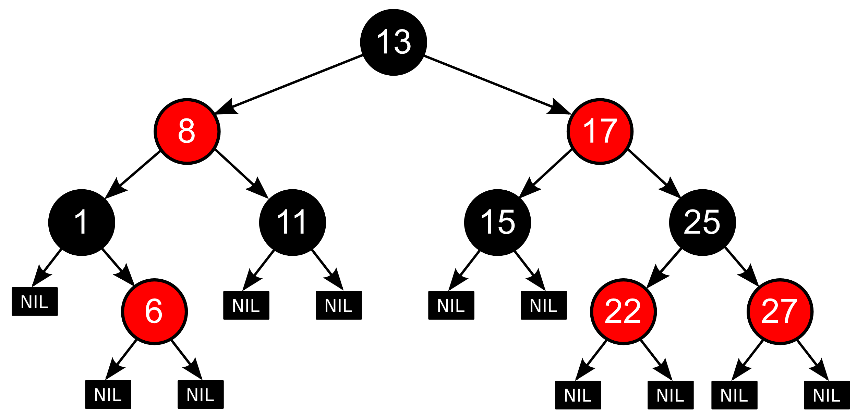
Rbtree recap
Every node is either Red or Black
Root is black
Leaves (which are NIL) are black
Red nodes can’t have red children
All paths have the same number of black nodes
Guarantees O(log n) for Insert, Delete, and finding minimum node
Also, self balancing

Slide 11
RBTree Functions
Helper functions:
Rotate left
Rotate right
Handle Node Removal Issues
Tree Operations
Insert
Delete
Tree Traversal
First
Last
Next
Prev

Slide 12
Implementation Decisions
Linux
Handles concurrency
Advanced memory management
Multiple tree traversal strategies
Production level code
Us
Not concurrent
Simple memory management
Only uses one traversal strategy
Only suitable for simulation

Slide 13
CFS Algorithm
When scheduler is invoked to run a new task
Leftmost node of tree is chosen and sent for execution
If process completes, remove from system and tree
If it reaches maximum execution time or is stopped, reinsert into tree
Reinsertion based on newly spent execution time
New leftmost node selected, repeating process
This ensures that process that spend a lot of time sleeping don’t get assigned a low priority – also is given a boost when it needs it
Notes:
Stopping would occur either voluntarily (within the process) or externally via interrupt
Tasks don’t get less processor time than tasks that are constantly running

Slide 14
CFS v O(1)
CFS
CFS
Pros
Predictable
Simple
Good for interactivity
Cons
Can lead to latency spikes
Expensive if lots of tasks
Memory overhead due to vruntime
O(1)
O(1)
Pros
Defined upper-bound runtime regardless of workload size
Cons
Unpredictable
Subject to miscalculations
Low responsiveness
Higher time complexity
“CFS Basically models an ‘ideal, precise multitasking CPU’ on real hardware” – Ingo Molnar

Slide 15

Program Design

Slide 16
System Architecture
Initialize workloads
1
Parse csv
2
Parse the CSVs into a queue of process structures
Design the CFS algorithm
3
Using python, we initialize workloads with semi-random values
Using a red-black tree for scheduling operations
These are generated as CSVs
Containing the necessary info for our scheduler

Slide 17
Process Design
We created a general process struct holding information relevant to each scheduler
We categorized attributes into
Basic
Timing
CFS required
State
Queue Management

Slide 18
Process Design
Base attributes needed
Process id
priority
Timing – contains necessary attributes for scheduling and simulation
Arrival time
First run time
Completion time
Total time
Burst time
Notes:
https://afteracademy.com/blog/what-is-burst-arrival-exit-response-waiting-turnaround-time-and-throughput/
-- Cover things here that relate to our project

Slide 19
Process Design
CFS specific attributes
vruntime
rb_node
State
We decided to use an enum for
NEW, READY, RUNNING, WAITING, and COMPLETED processes
Queue Management
Keep track of next and previous process in queue

Slide 20
Metrics
Response Time
first runtime – arrival time
Turnaround Time
completion time – start time
Virtual Runtime Variance
delta_exec_weighed = delta_exec * (NICE_0_LOAD / curr->load.weight)

Slide 21
Show code

Slide 22
Final Thoughts
Generally, the drawbacks of CFS aren’t noticeable
For most cases, the default CFS algorithm works well enough
In modern OS, there usually aren’t enough tasks to cause performance decreases
For specialized cases, tuning options are available within the Linux kernel
For real-time tasks, the Linux kernel makes 2 separate schedulers available
SCHED_RR and SCHED_FIFO
If you have a highly specialized system, you can make a scheduler to fit your needs as the Linux kernel is modular

